Slide 1
Visualizing CNN
Visualizing and understanding Convolutional Neural Networks

Slide 2
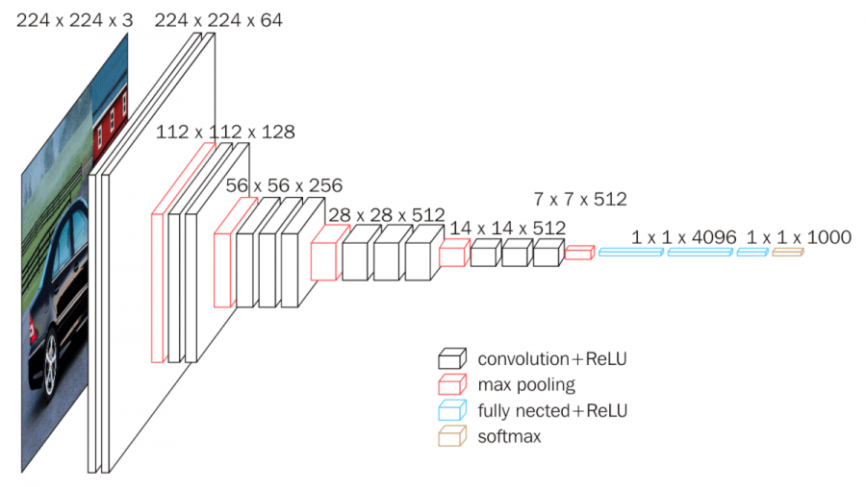
Motivation
Understanding how CNNs work/network decisions
Why so many features/nodes/layers, and computational complexity?
Debugging
VGG16 Architecture

Slide 3
Motivation
Understanding how CNNs work/network decisions
Why so many features/nodes/layers, and computational complexity?
Debugging
Each node learns/captures different feature of the input. We need multiple nodes to capture features of complex data.
We’ll visualize the filters (activations) and weights across layers to see the features captured by each of the activation/weights.

Slide 4
Visualizing Kernels/raw weights
We take a pre-trained VGG16 in-order to visualize weights.
As shown in the architecture, the input is an RGB image, so it has 3 Channels.
First and the second layers have
64 filters.
VGG16 Architecture

Slide 5
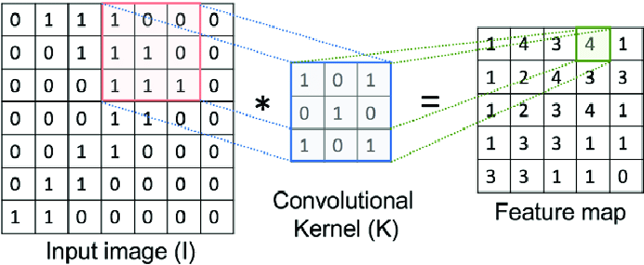
Visualizing Kernels/raw weights
We take a pre-trained VGG16 in-order to visualize weights.
As shown in the architecture, the input is an RGB image, so it has 3 channels.
First and the second layers have 64 channels/kernels (of 3x3 size).
So, between the input and the first convolution layer, we’ll have 64x3x3 channels in 3 channels

Slide 6
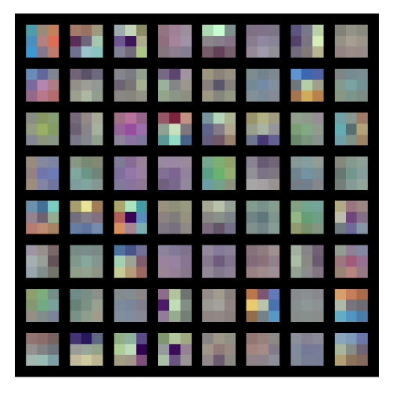
Weights between input layer and first Convolution layer (64 3x3x3)

Slide 7
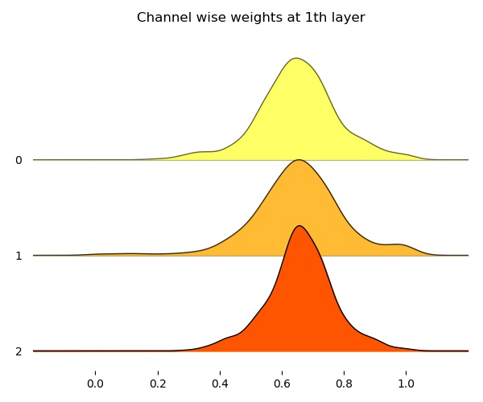
Histogram of kernels - comparison across the 3 channels

Slide 8
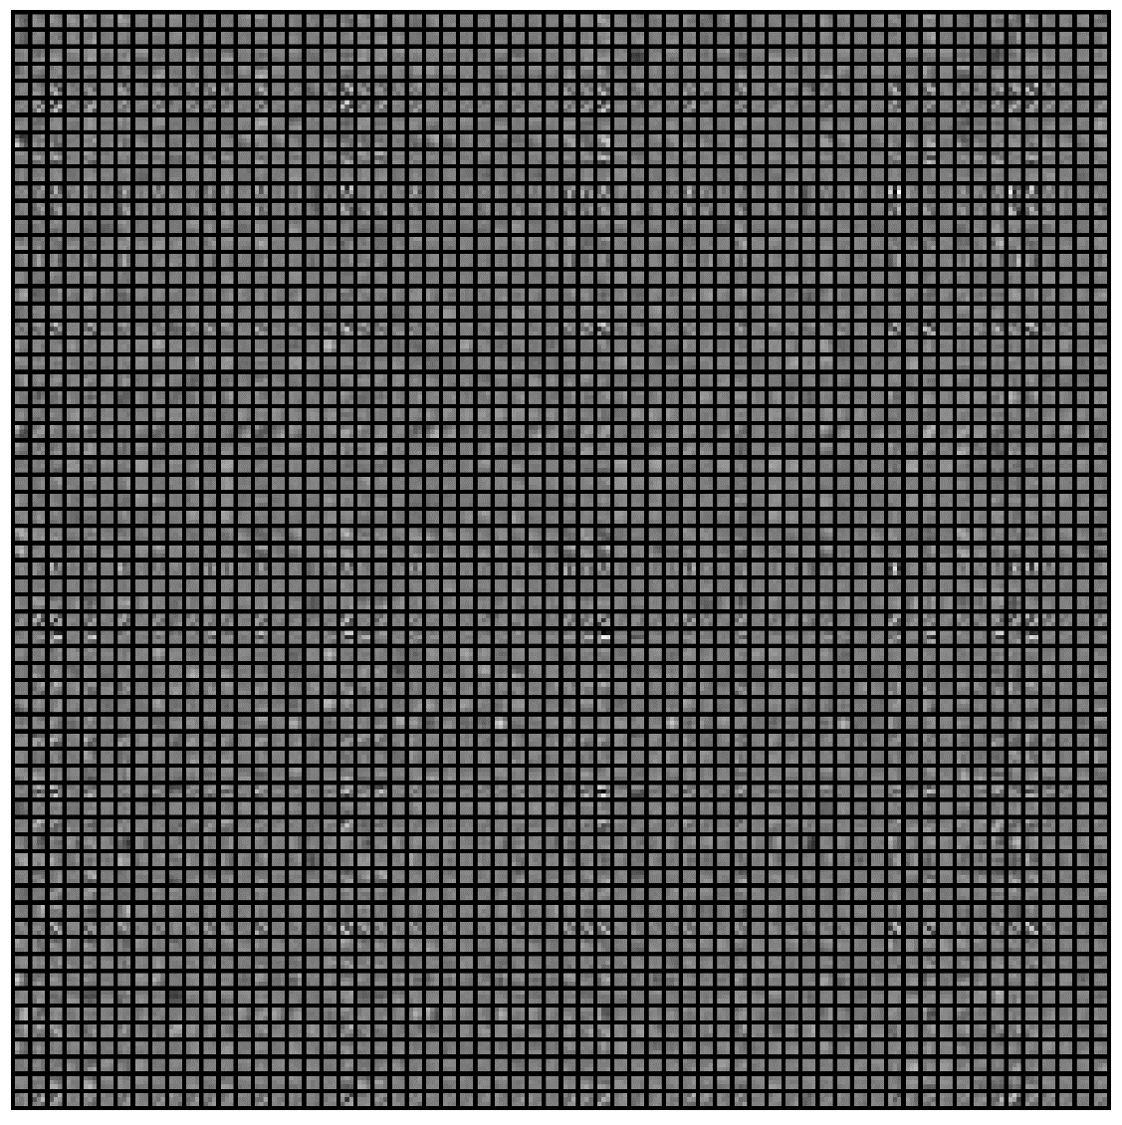
Kernels between first and second convolution layers (64*64 3x3)

Slide 9
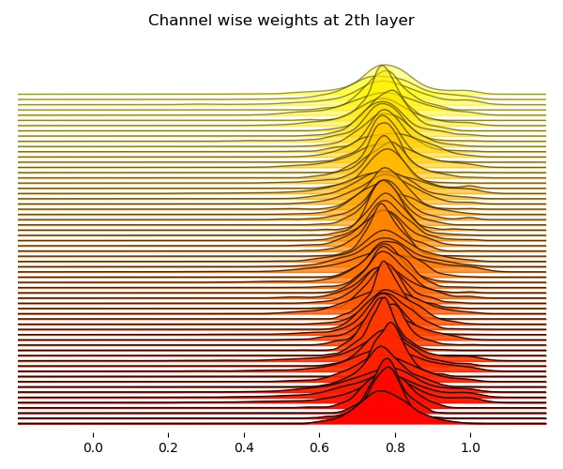
Histogram of kernels between first and second convolution layers – different channels

Slide 10
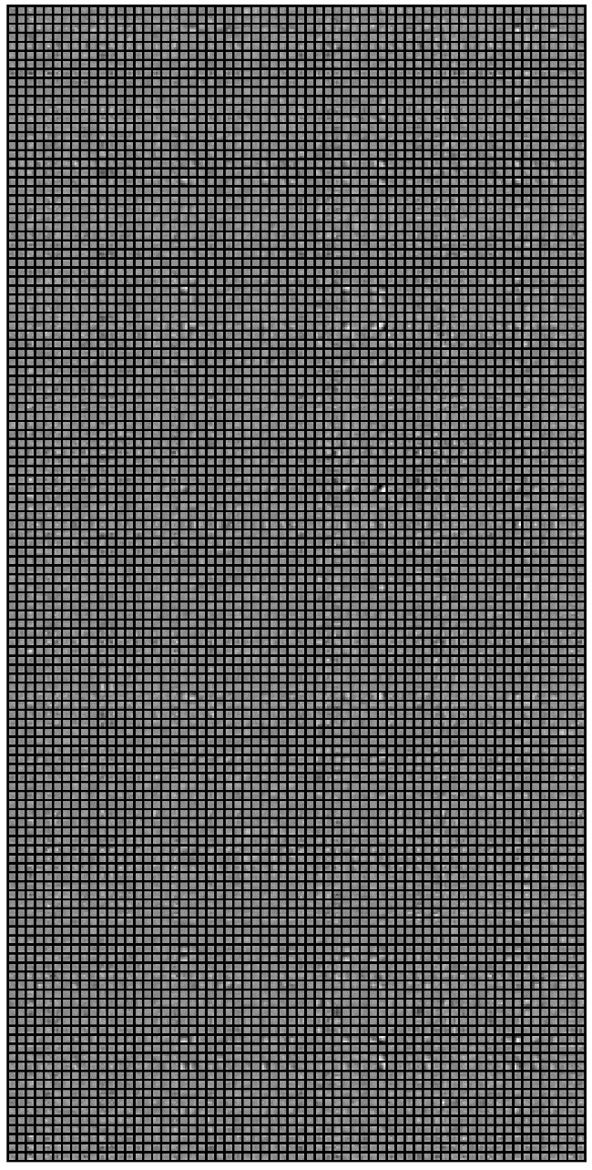
Kernels between second and third convolution layers (64*128 3x3)

Slide 11
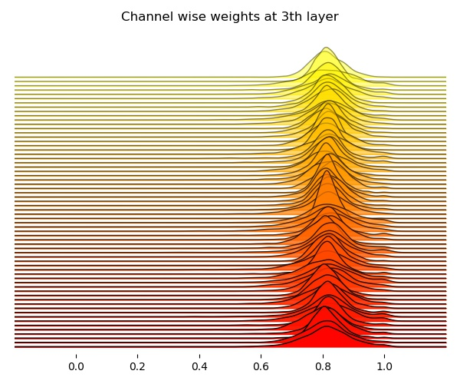

Slide 12
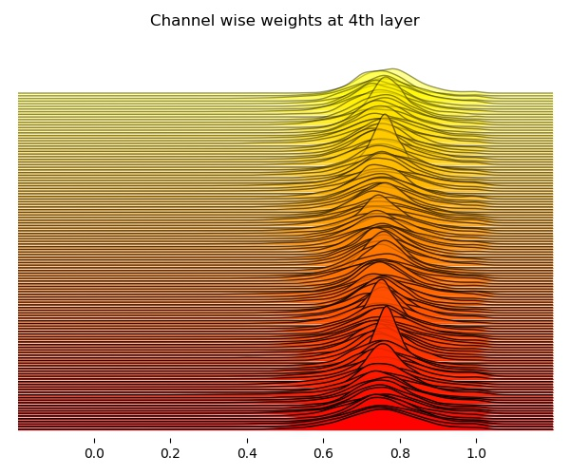

Slide 13
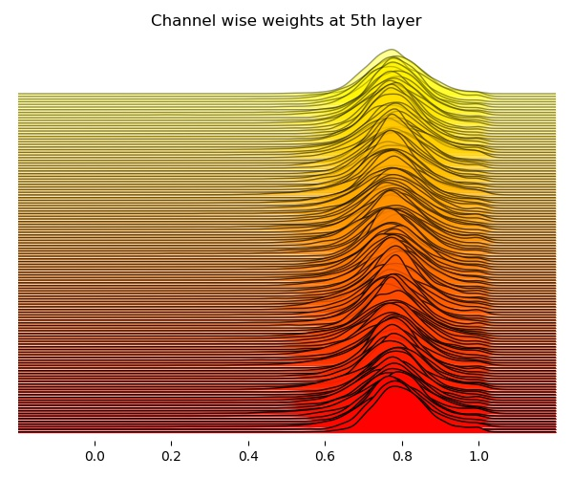

Slide 14
Visualizing Feature/Activation Maps
When an input image passes through a node/neuron, which pixels activate it?
We pass an input image and check the part of it that activates the neuron the most.
Back propagate the activation after one forward pass of the input, to find the gradient at the neuron with respect to the image.

Slide 15
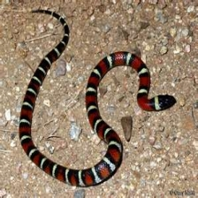
Visualizing Feature/Activation Maps
Guided Backpropagation
Idea: neurons act like detectors of particular image features
We are only interested in what image features the neuron detects, not in what kind of stuff it doesn’t detect
So when propagating the gradient, we set all the negative gradients to 0
We don’t care if a pixel “suppresses” a neuron somewhere along the part to our neuron
Ref: https://www.cs.toronto.edu/~guerzhoy/321/lec/W07/HowConvNetsSee.pdf

Slide 16
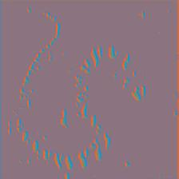
Activation at Layer 1 Filter 0 using Guided Backprop

Slide 17
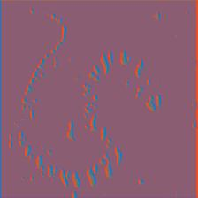
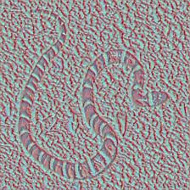
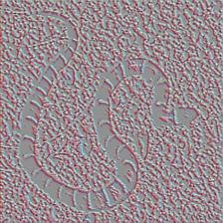
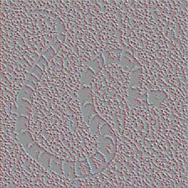
Activation map at specific neurons using Guided Backprop
Layer 1 Filter 0
Layer 2 Filter 0
Layer 3 Filter 0
Layer 4 Filter 0
Layer 5 Filter 0

Slide 18
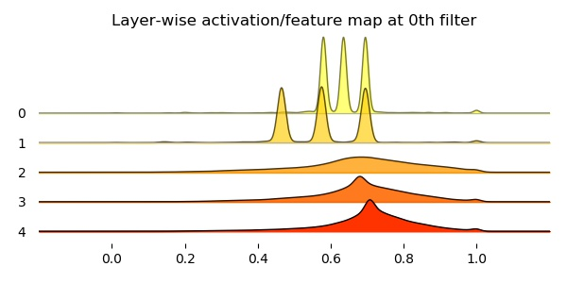
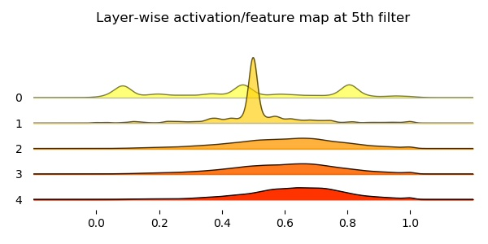

Slide 19
